Slide 1
SGKB x IBM
Personal Finance Manager

Slide 2
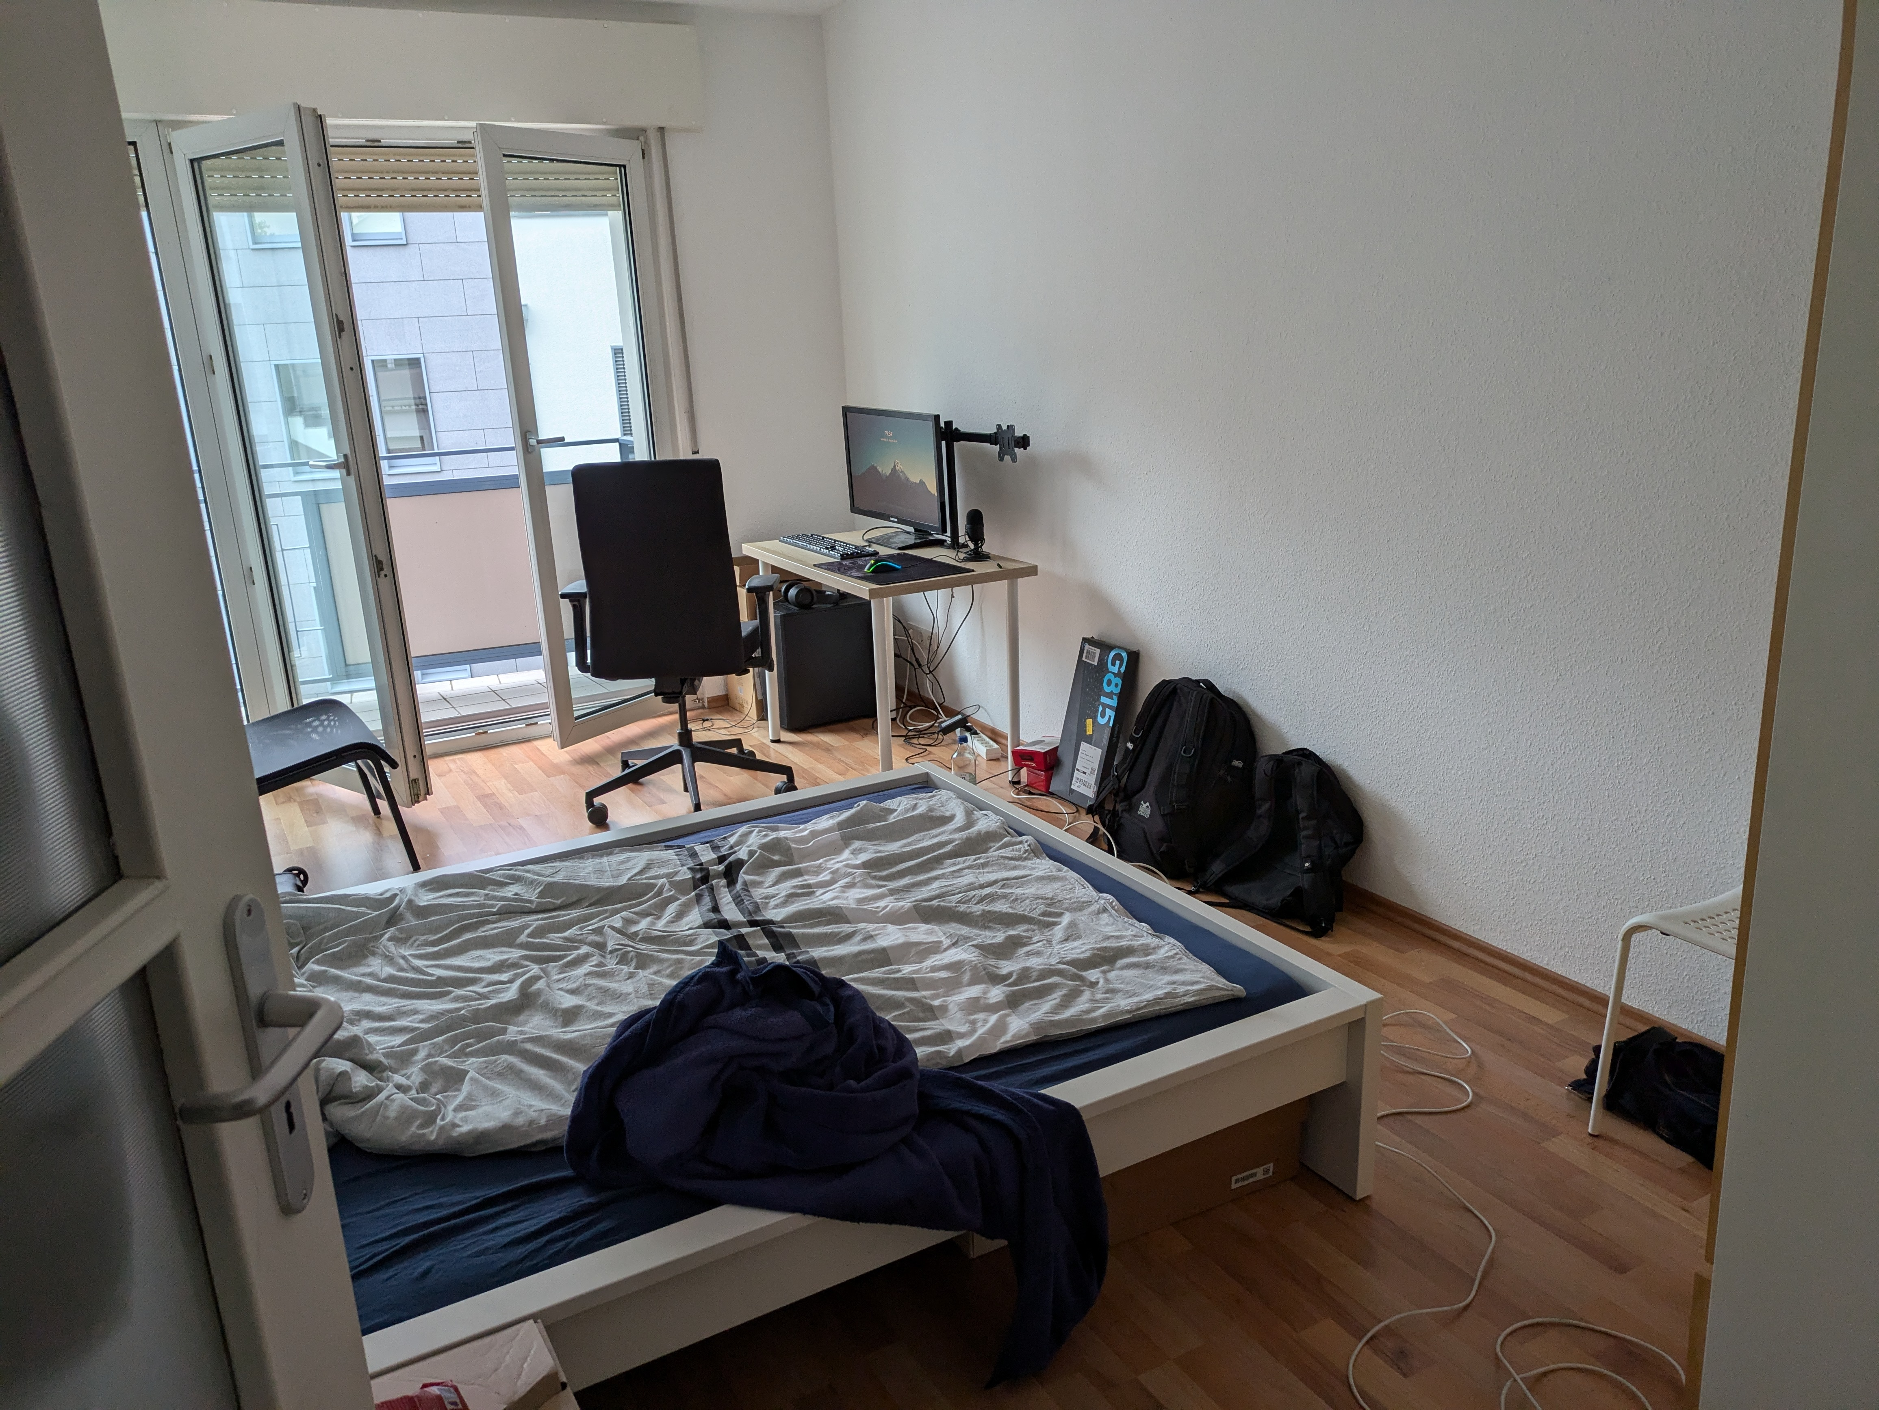


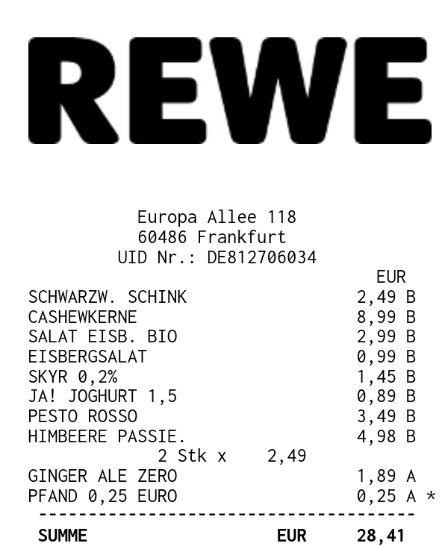

Slide 3
Features?

Slide 4
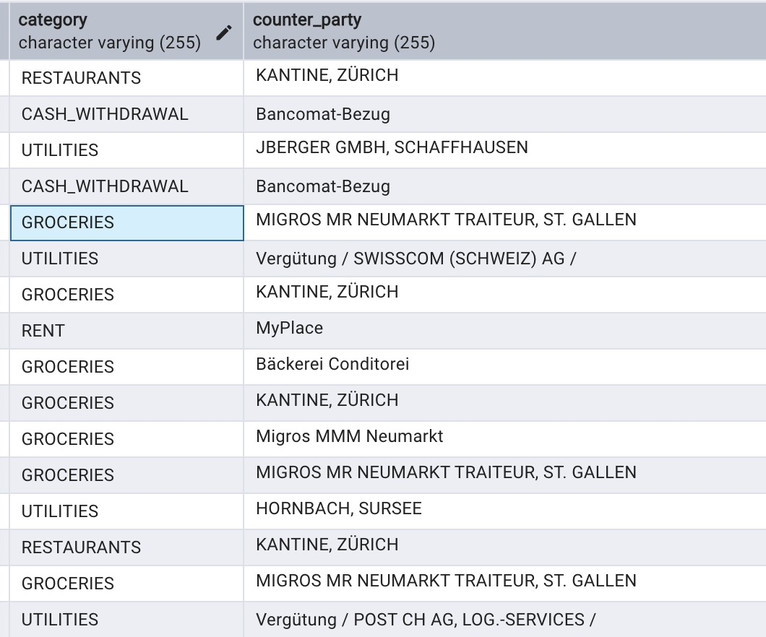
Transaction Clustering

Slide 5
Spending Goals

Slide 6
Saving Goals

Slide 7
Voice Commands

Slide 8
Demo

Slide 9
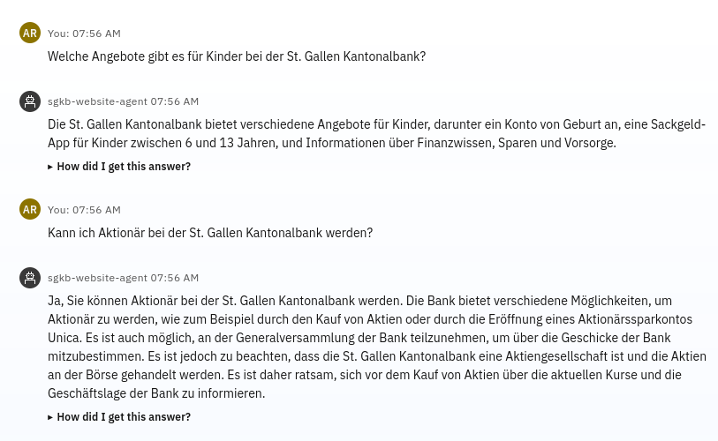

Slide 10
Q & A

